Slide 1



Introduction to
Social Media Analytic
Dian Ramadhani
1

Slide 2

Dian Ramadhani
Pengalaman
Product and Research Lead di Digital Business Ecosystem Research Center
Peneliti di Social Computing and Big Data
Trainer di Berbagai Pelatihan dan Sertifikasi Terkait Data Driven Decision Making
Pendidikan
Universitas Telkom – Magister Manajemen (S2)
Universitas Telkom – Manajemen Bisnis Teknologi Informatika (S1)
Penghargaan
Best Graduate Magister Manajemen Universitas Telkom 2019
Beasiswa Program Studi Magister Universitas Telkom
Beasiswa PPA Tahun 2016 dan 2017
Best Presenter Konferensi Internasional IWBIS 2018 dan 2019

Slide 3

Learning Outline
Human Data Production
Social Media Analytic Importance

Slide 4
Learning Outline
Introduction
Network Representation
Tie Strength
Influencer Identification
Overall Social Network Structure
Human Data Production

Slide 5
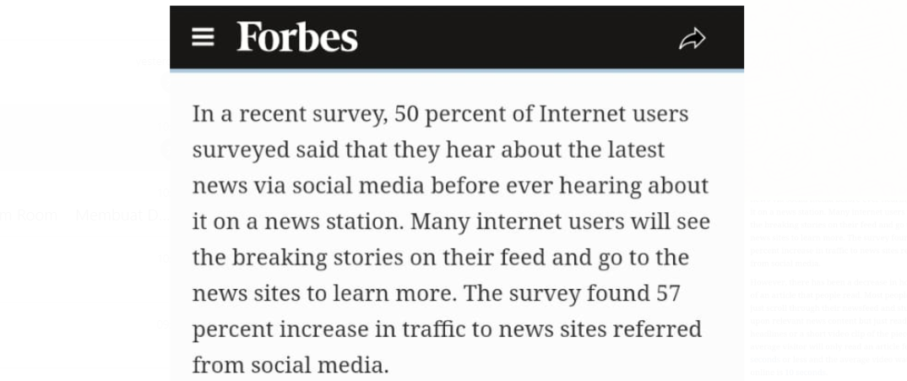

Slide 6
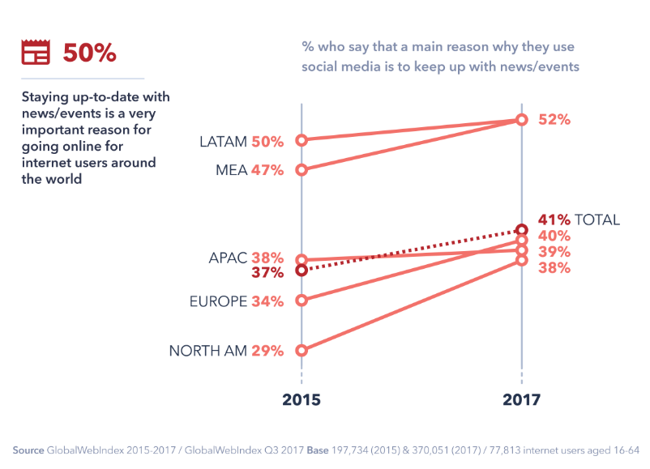
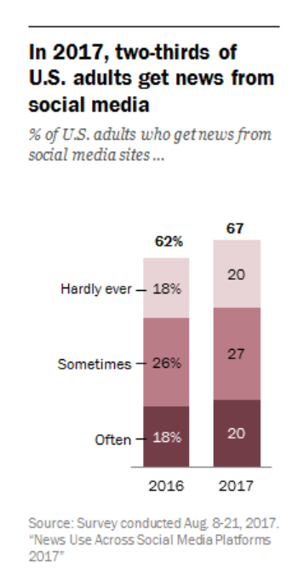

Slide 7
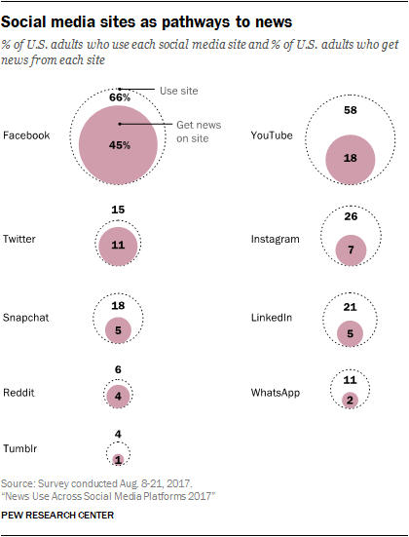

Slide 8
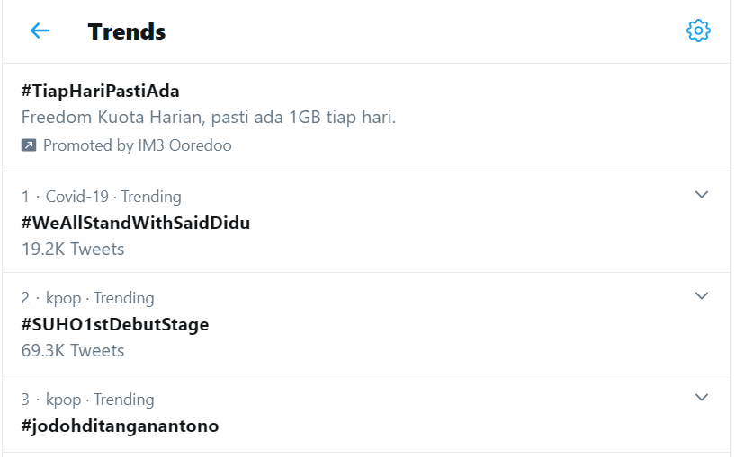
Human Data Production

Slide 9
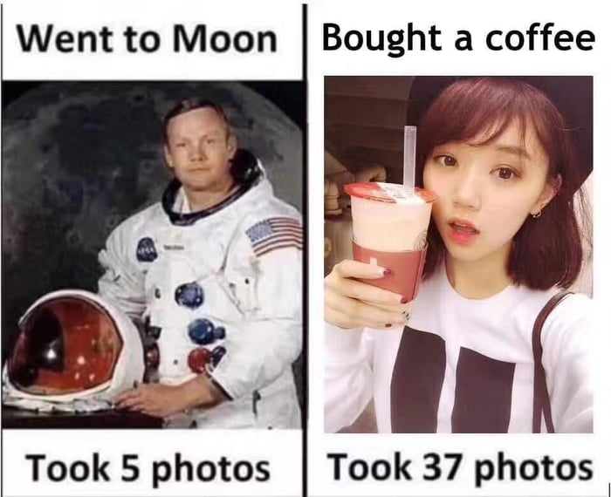
Human Data Production

Slide 10
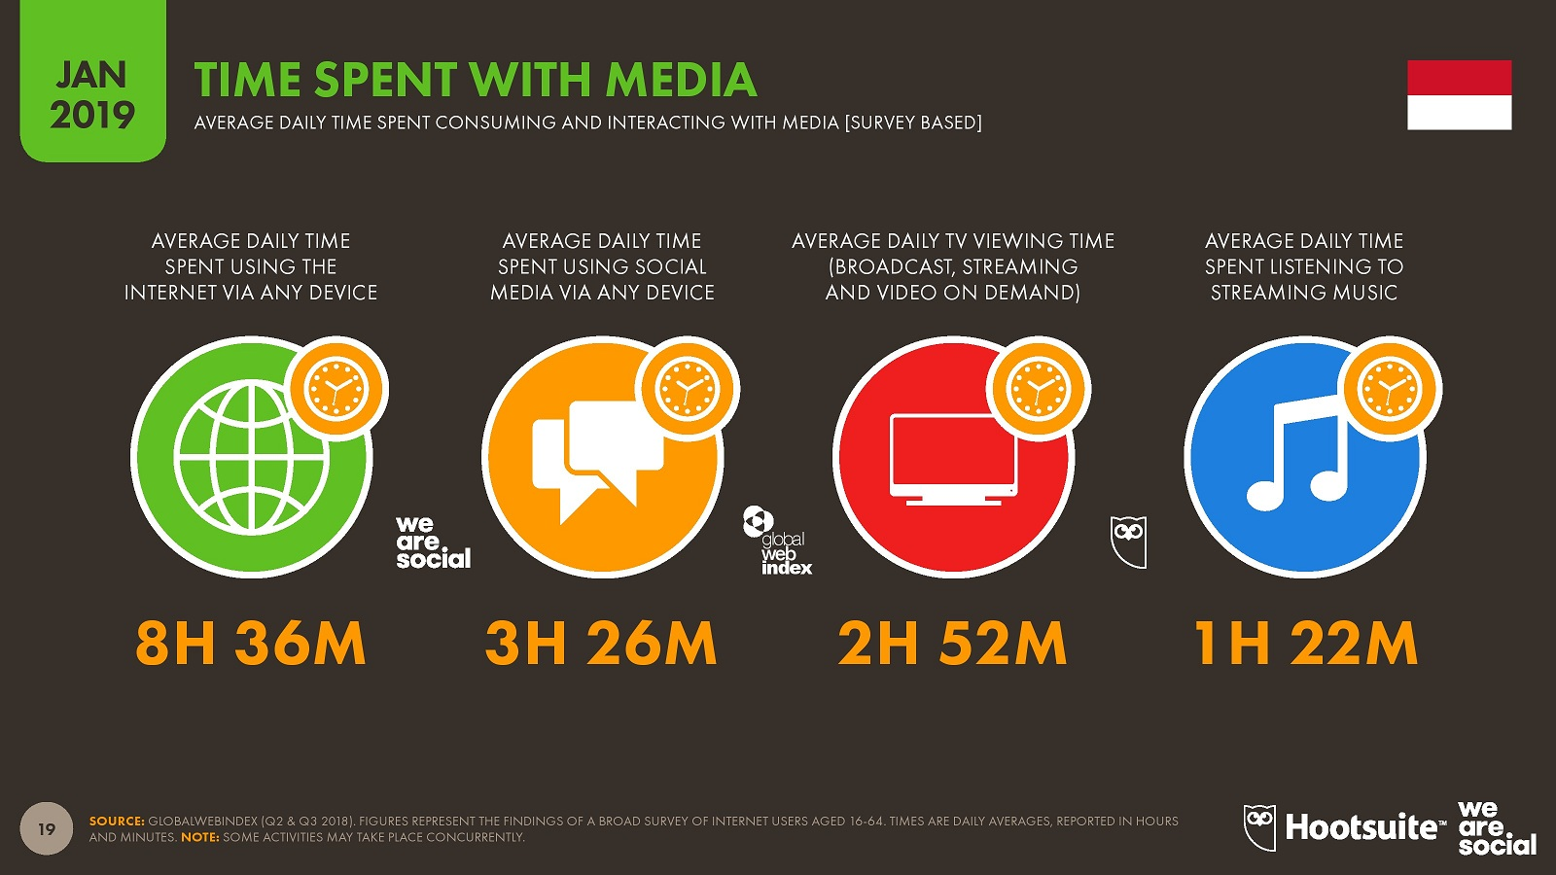

Slide 11
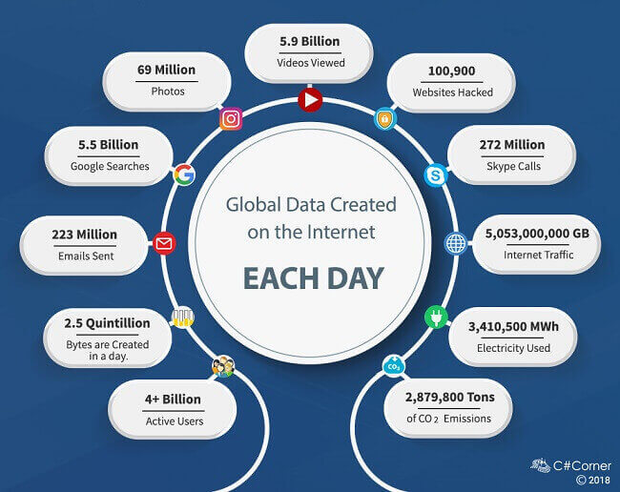
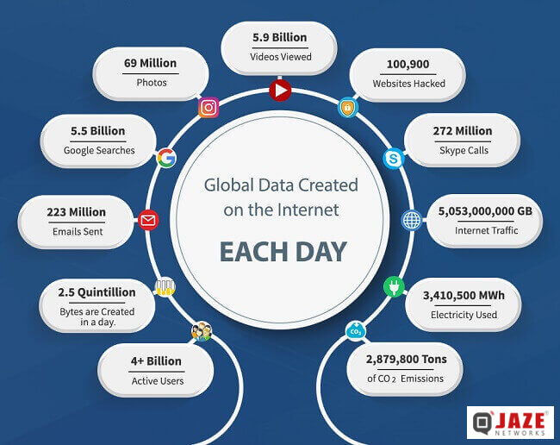

Slide 12
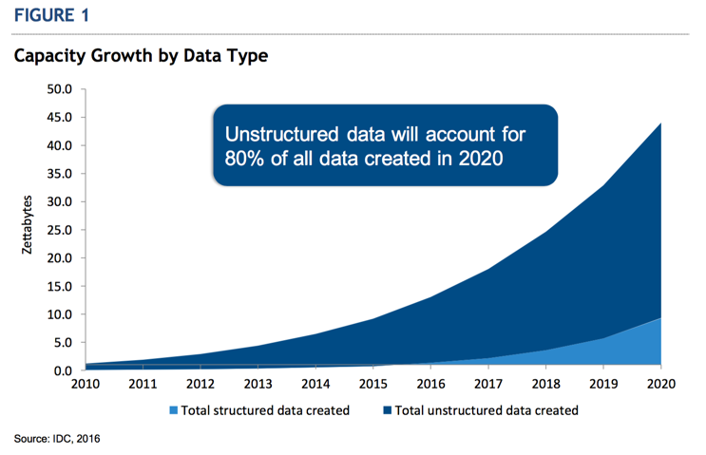
https://www.ibm.com/blogs/cloud-computing/2016/12/13/idc-stacks-top-object-storage-vendors/

Slide 13
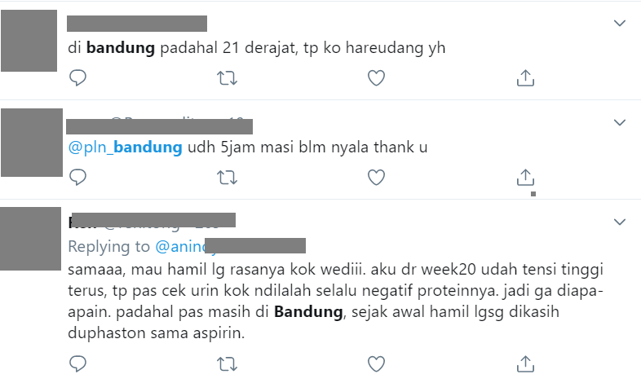
Structured Data vs Unstructured Data
Structured Data
Unstructured Data
High Degree of Organization, such as a relational database
Information that is difficult to organize using traditional mechanisms
Name | Age | Address
Dian | 23 | Medan
Rafa | 22 | Karawang
Dito | 22 | Wonogiri

Slide 14
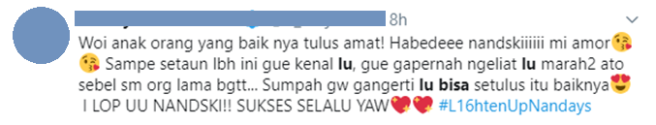
Kita tidak sedang baik – baik saja ketika menemukan data yang suuuper berantakan

Slide 15

Noise
Insight
Insight
Insight
Bot
Fully Unstructured

Slide 16
Learning Outline
Introduction
Network Representation
Tie Strength
Influencer Identification
Overall Social Network Structure
Social Media Analytic Importance

Slide 17

Social media analytics refers to the approach of collecting data from social media sites and evaluating them to make an insightful decision making.

Slide 18
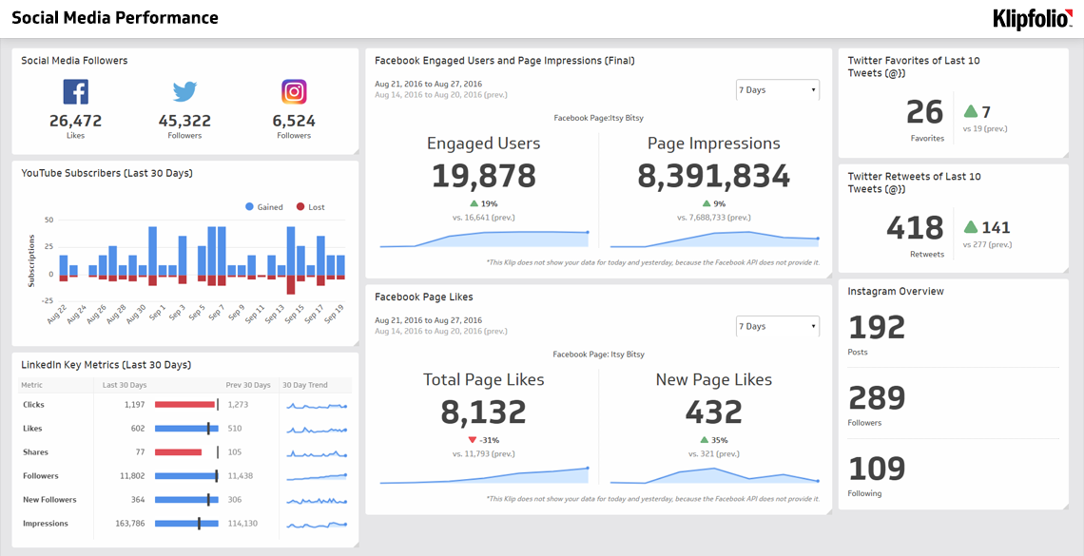

Slide 19
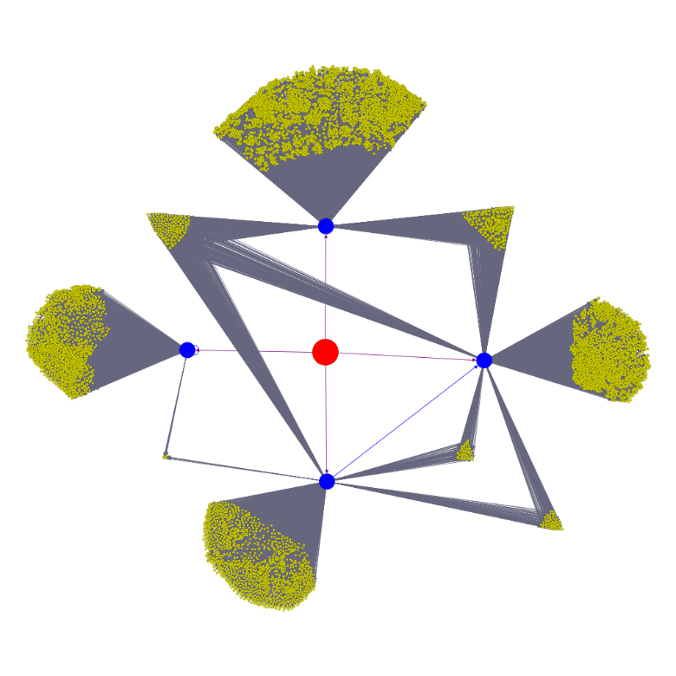
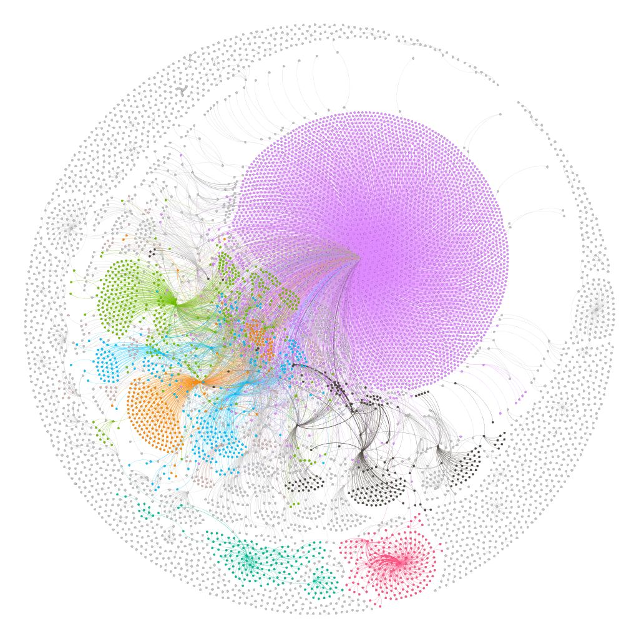
Discover Information Spread Mechanism
7203
303
1041
1889
9817
64
43
1663

Slide 20
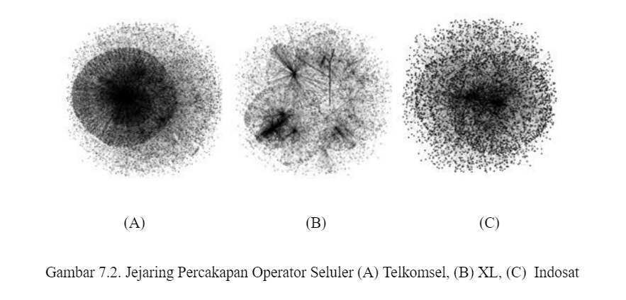
Discover Brand Information Spread

Slide 21
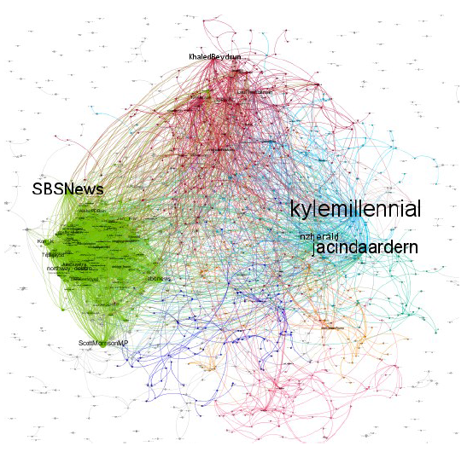
Discover Christchurch Attack Information Spread

Slide 22
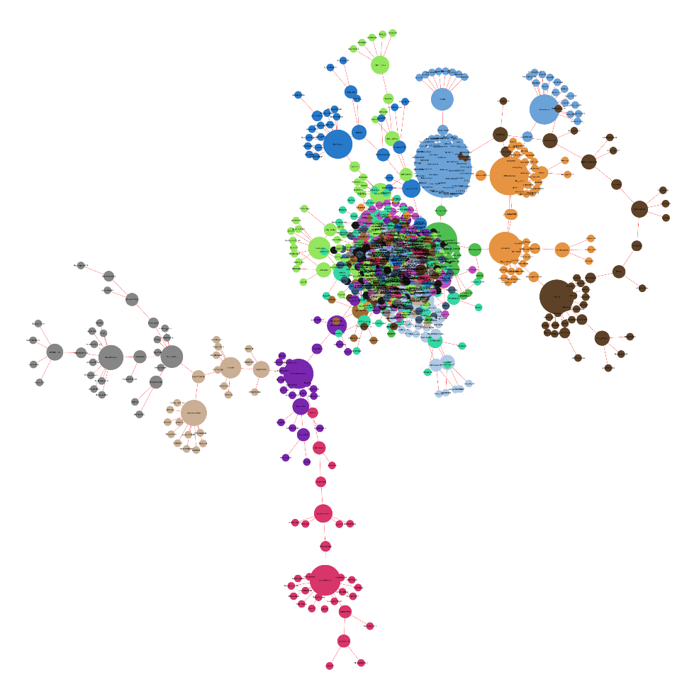
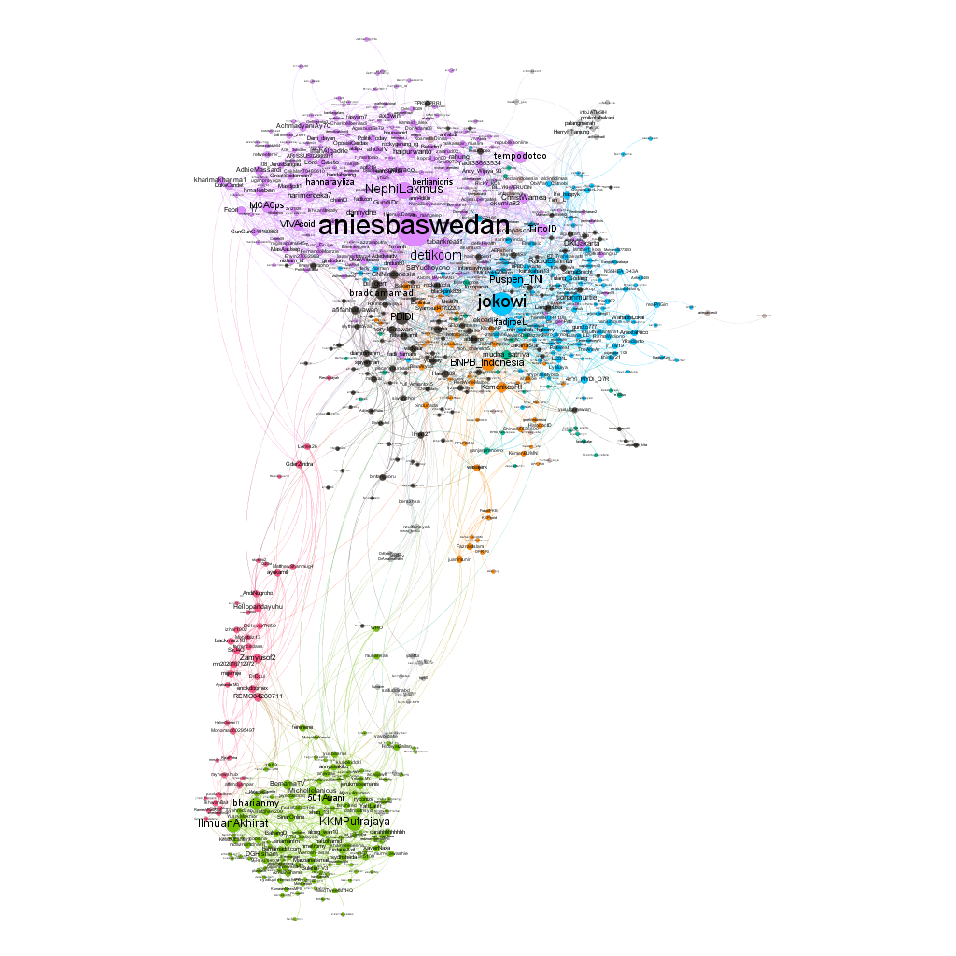
Discover Covid-19 Information Spread in Indonesia
Early March End of March

Slide 23
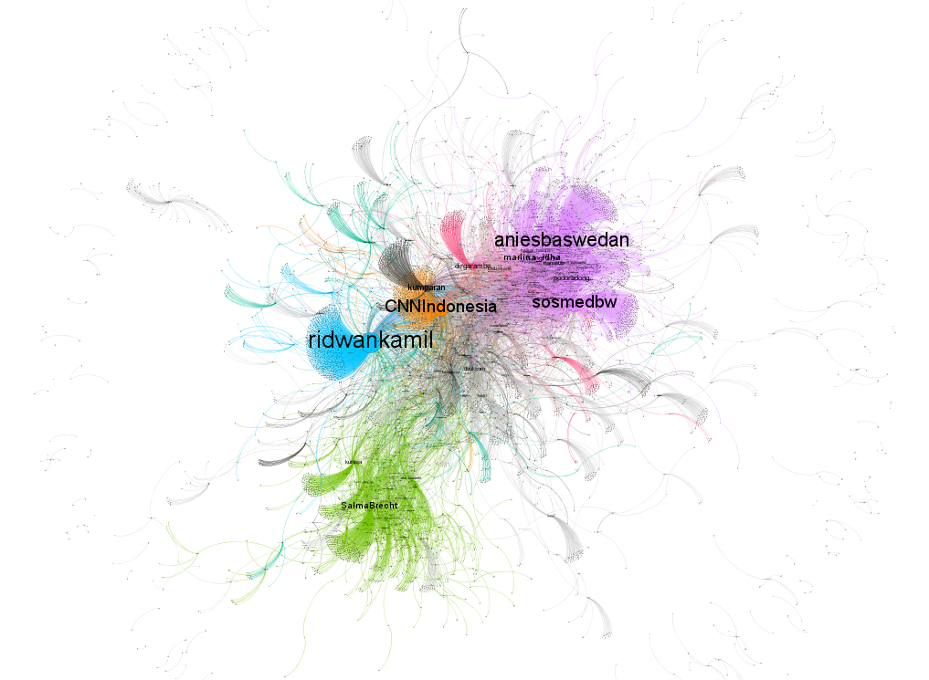
Discover PSBB Information Spread

Slide 24
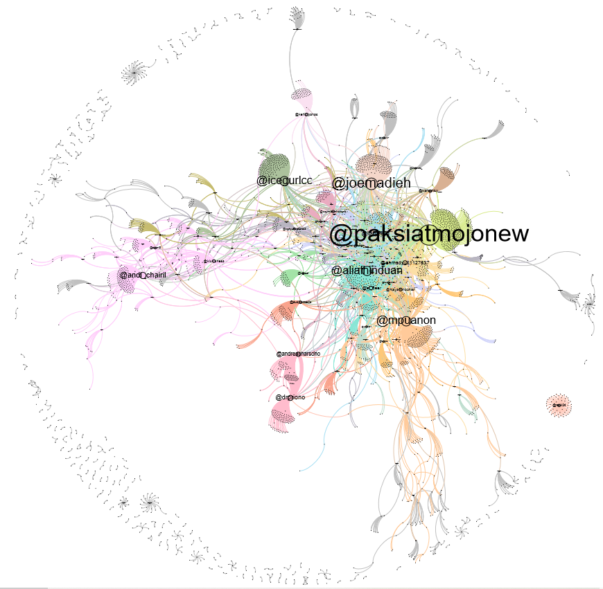
Discover Indonesiaterserah Information Spread

Slide 25
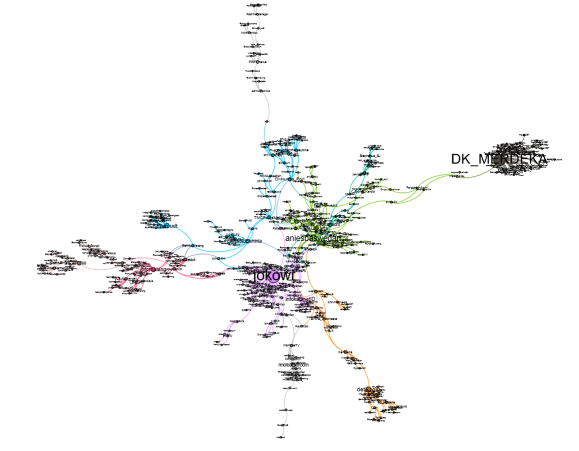
Discover Mudik Information Spread

Slide 26
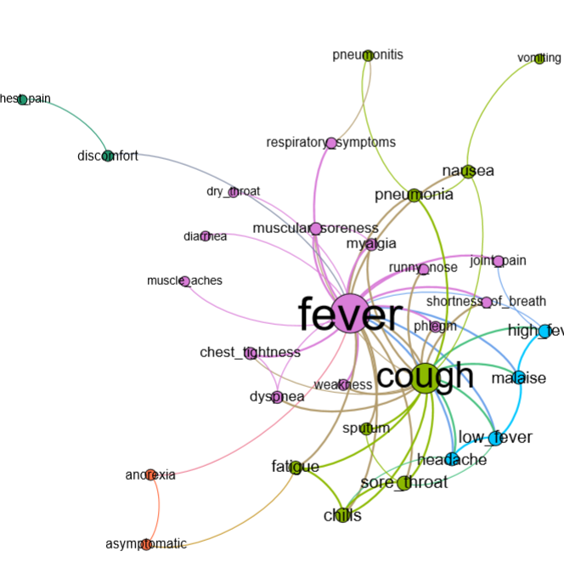
Discover Covid-19 Symptom Relation

Slide 27
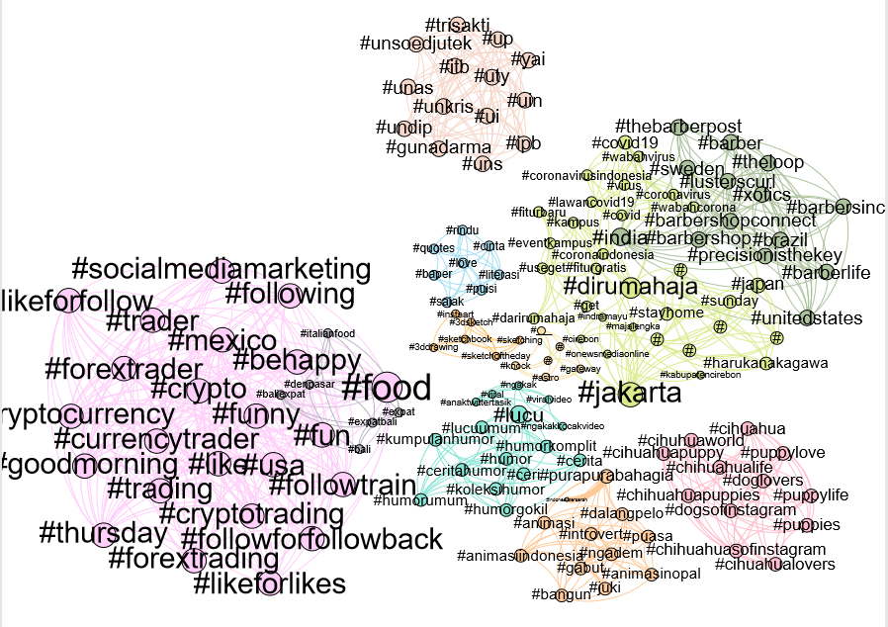
Discover Hashtag Relation

Slide 28
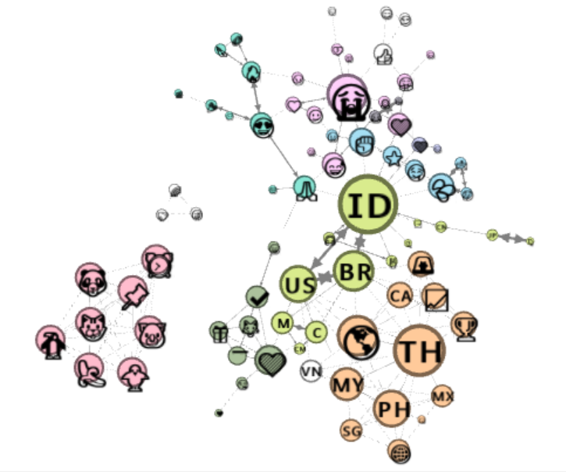
Discover Emoji Relation

Slide 29
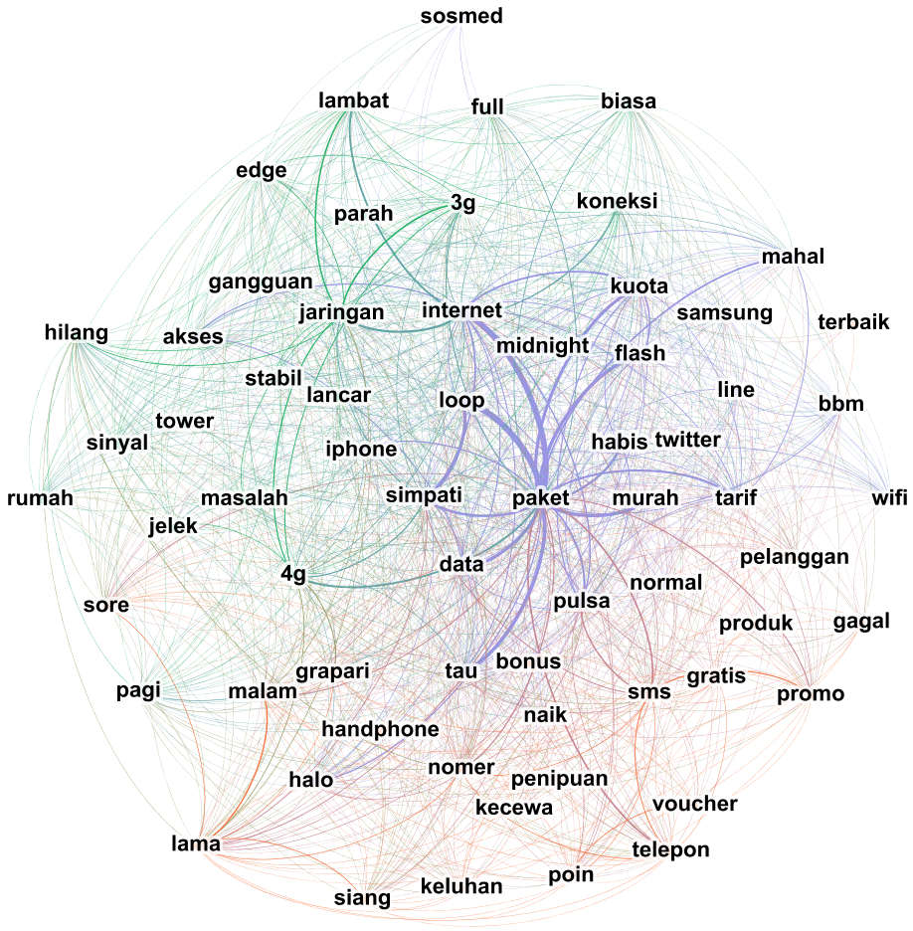
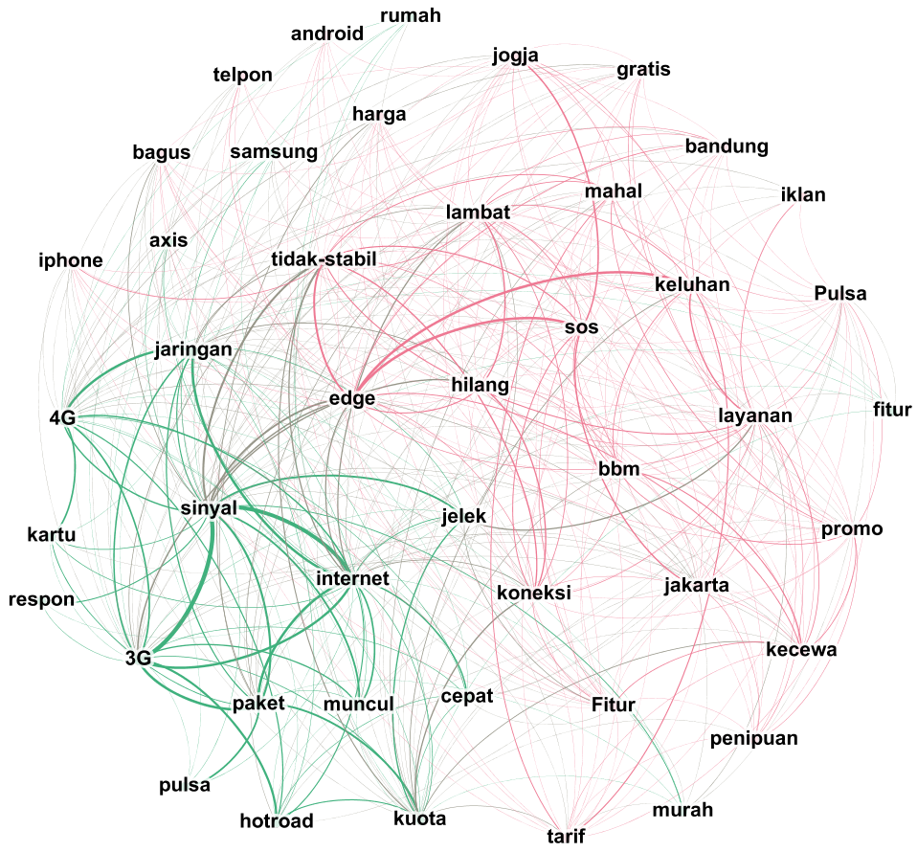
Discover Customer Opinion

Slide 30
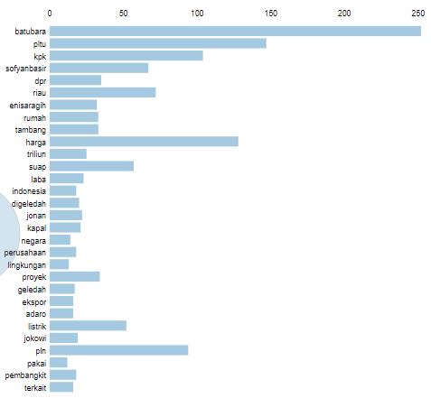
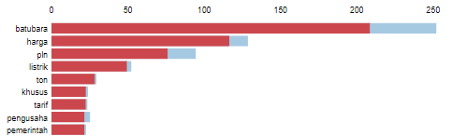
s
Discover the Top Topics

Slide 31
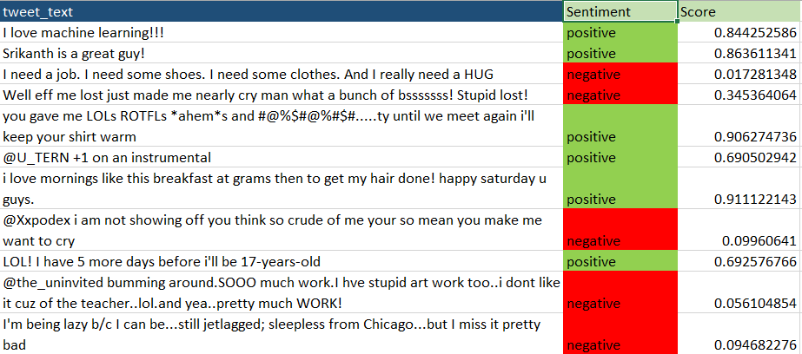
s
Discover the Information Sentiment

Slide 32
Challenges
Opportunities
Huge volumes of data
Incomplete pictures
Data relevance
Data quality
Uncovering hidden truth
Track social campaigns
Create better content
Competitive benchmarking

Slide 33

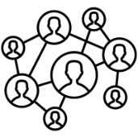

Social Media Analytics Workflow
Social Media Platform
Analytics
Create winning social media campaigns
Find the best influencers for your brand
Benchmark against your competitors
Identify trending topics
Raw Data
Interaction
Content
API Access
Pre-processing
Clean Data

Slide 34
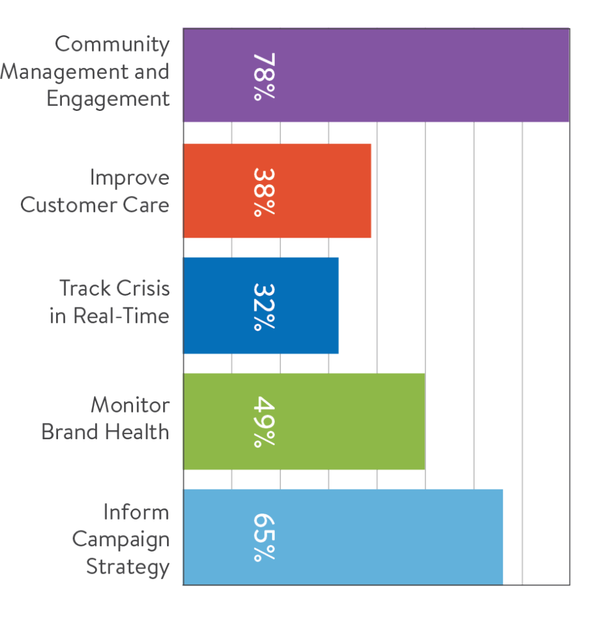

Slide 35
Thank You
Dian Ramadhani
2

